Slide 1
CSE 3002- programming in java unit Iv Java I/O Fundamentals
Dr. R. Manikandan
Assistant professor (senior grade)
Vit bhopal university

Slide 2
Java I/O Basics
The Java programming language provides a comprehensive set of libraries to perform input/output (I/O) functions.
Java defines an I/O channel as a stream.
An I/O stream represents an input source or an output destination.
An I/O stream can represent many different kinds of sources and destinations, including disk files, devices, other programs, and memory arrays.
I/O streams support many different kinds of data, including simple bytes, primitive data types, localized characters, and objects.
Some I/O streams simply pass on data; others manipulate and transform the data in useful ways.
Notes:
Some I/O streams simply pass on data; others manipulate and transform the data in useful ways.

Slide 3
I/O Streams
Java I/O (Input and Output) is used to process the input and produce the output.
Java uses the concept of a stream to make I/O operation fast. The java.io package contains all the classes required for input and output operations.
Stream
A stream is a sequence of data. It's called a stream because it is like a stream of water that continues to flow. In Java, a stream is composed of bytes.

Slide 4
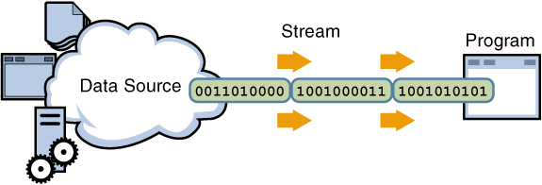
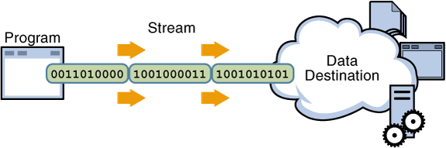
I/O Streams
A program uses an input stream to read data from a source, one item at a time.
A program uses an output stream to write data to a destination (sink), one item at time.
Notes:
No matter how they work internally, all streams present the same simple model to programs that use them. A stream is a sequential flow of data. A stream can come from a source or can be generated to a sink.
A source stream initiates the flow of data, also called an input stream.
A sink stream terminates the flow of data, also called an output stream.
Sources and sinks are both node streams. Types of node streams are files, memory, and pipes between threads or processes.

Slide 5




I/O Application
Typically, a developer uses input and output in three ways:
Files and
directories
Console: (standard-in, standard-out)
Socket-based sources
Notes:
An application developer typically uses I/O streams to read and write files, to read information from and write information to some output device, such as the keyboard (standard in) and the console (standard out). Finally, an application may need to use a socket to communicate with another application on a remote system.

Slide 6
I/O Application
An application developer typically uses I/O streams to read and write files, to read information from and write information to some output device, such as the keyboard (standard in) and the console (standard out).
Finally, an application may need to use a socket to communicate with another application on a remote system.

Slide 7
Data Within Streams
Java technology supports two types of data in streams: raw bytes and Unicode characters. Typically, the term stream refers to byte streams and character streams.
Byte streams are best applied to reading and writing of raw bytes (such as image files, audio files, and objects). Specific subclasses provide methods to provide specific support for each of these stream types.
Character streams are designed for reading characters (such as in files and other character-based streams). Specific subclasses provide methods to provide specific support for each of these stream types.
Stream | Byte Streams | Character Streams
Source streams | InputStream | Reader
Sink streams | OutputStream | Writer

Slide 8
Byte Stream
A byte stream access the file byte by byte. Java programs use byte streams to perform input and output of 8-bit bytes.
Byte oriented streams do not use any encoding scheme while Character oriented streams use character encoding scheme(UNICODE).
All byte stream classes are descended from InputStream and OutputStream .
Example: ByteStreamCopyTest.java, ByteStreamCopyTest1.java

Slide 9
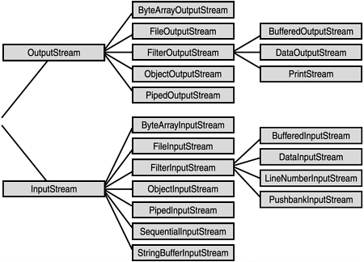
Byte Stream

Slide 10
Byte Stream: Sub Classes
FileInputStream and FileOutputStream
Read data from or write data to a file on the native file system.
ByteArrayInputStream and ByteArrayOutputStream
Read data from or write data to a byte array in memory.
SequenceInputStream
Concatenate multiple input streams into one input stream.
StringBufferInputStream
Allow programs to read from a StringBuffer as if it were an input stream.
PipedInputStream and PipedOutputStream
Implement the input and output components of a pipe.
Pipes are used to channel the output from one program (or thread) into the input of another.

Slide 11
Byte Stream: Sub Classes
FilterInputStream and FilterOutputStream
Filtered streams which process data as it's being read or written.
Sub Classes
DataInputStream and DataOutputStream
Read or write primitive Java data types in a machine-independent format.
BufferedInputStream and BufferedOutputStream
Buffer data while reading or writing, thereby reducing the number of accesses required on the original data source.
Buffer data while reading and writing to speed it up.
LineNumberInputStream
Keeps track of line numbers while reading.

Slide 12
Byte Stream: Sub Classes
PushbackInputStream
An input stream with a one-byte pushback buffer. Sometimes when reading data from a stream it is useful to peek at the next character in the stream in order to decide what to do next.
If you peek at a character in the stream, you'll need to put it back so that it can be read again and processed normally.
PrintStream
An output stream with convenient printing methods.
Example: ByteStreamCopyTest.java, ByteStreamCopyTest1.java

Slide 13
InputStream and OutputStram Methods
InputStream: The three basic read methods are:
int read()
int read(byte[] buffer)
int read(byte[] buffer, int offset, int length)
Other methods include:
void close(); // Close an open stream
int available(); // Number of bytes available
long skip(long n); // Discard n bytes from stream
OutputStream:The three basic write methods are:
void write(int c)
void write(byte[] buffer)
void write(byte[] buffer, int offset, int length)
Other methods include:
void close(); // Automatically closed in try-with-resources
void flush(); // Force a write to the stream
Notes:
InputStream Methods
The read() method returns an int, which contains either a byte read from the stream, or a -1, which indicates the end-of-file condition. The other two read methods read the stream into a byte array and return the number of bytes read. The two int arguments in the third method indicate a subrange in the target array that needs to be filled.
Note: For efficiency, always read data in the largest practical block, or use buffered streams.
When you have finished with a stream, close it. If you have a stack of streams, use filter streams to close the stream at the top of the stack. This operation also closes the lower streams.
InputStream implements AutoCloseable, which means that if you use an InputStream (or one of its subclasses) in a try-with-resources block, the stream is automatically closed at the end of the try.
The available method reports the number of bytes that are immediately available to be read from the stream. An actual read operation following this call might return more bytes.
The skip method discards the specified number of bytes from the stream.

Slide 14
Character Stream
A character stream will read a file character by character.
Character Stream is a higher level concept than Byte Stream . A Character Stream is, effectively, a Byte Stream that has been wrapped with logic that allows it to output characters from a specific encoding .
That means, a character stream needs to be given the file's encoding in order to work properly.
Character stream can support all types of character sets ASCII, Unicode, UTF-8, UTF-16 etc.
All character stream classes are descended from Reader and Writer .
Example: CharacterStreamCopyTest.java, CharacterStreamCopyTest1.java

Slide 15
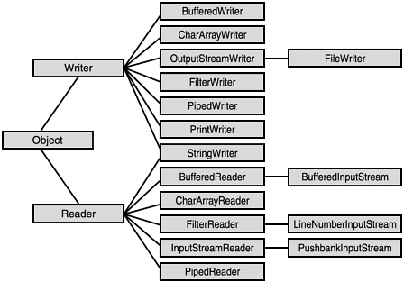
Character Stream

Slide 16
Reader and Writer Methods
Reader: The three basic read methods are
int read()
int read(char[] cbuf)
int read(char[] cbuf, int offset, int length)
Other methods include:
void close()
boolean ready()
long skip(long n)
boolean markSupported()
void mark(int readAheadLimit)
void reset()
Notes:
Reader Methods
The first method returns an int, which contains either a Unicode character read from the stream, or a -1, which indicates the end-of-file condition. The other two methods read into a character array and return the number of bytes read. The two int arguments in the third method indicate a subrange in the target array that needs to be filled.

Slide 17
Reader and Writer Methods
Writer: The basic write methods are:
void write(int c)
void write(char[] cbuf)
void write(char[] cbuf, int offset, int length)
void write(String string)
void write(String string, int offset, int length)
Other methods include:
void close()
void flush()
Notes:
Reader Methods
The first method returns an int, which contains either a Unicode character read from the stream, or a -1, which indicates the end-of-file condition. The other two methods read into a character array and return the number of bytes read. The two int arguments in the third method indicate a subrange in the target array that needs to be filled.

Slide 18
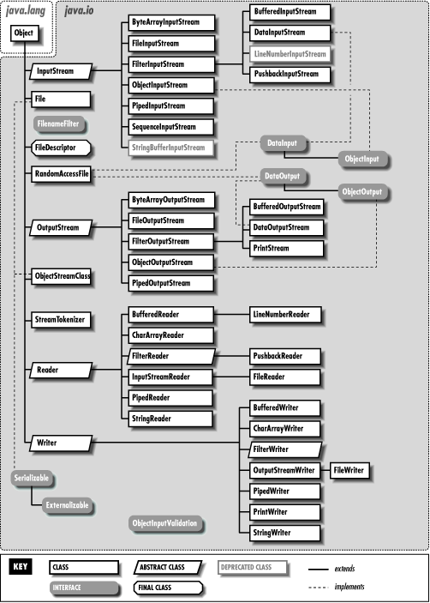
Java IO Hierarchy

Slide 19
I/O Stream Chaining
A program rarely uses a single stream object. Instead, it chains a series of streams together to process the data.
Example: BufferedStreamCopyTest.java
Data Source
Program
File Input Stream
Buffered Input Stream
Data Input Stream
The first graphic in the slide demonstrates an example of input stream; in this case, a file stream is buffered for efficiency and then converted into data (Java primitives) items.
Program
Data Sink
Buffered Output Stream
File Output Stream
Data Output Stream
The second graphic demonstrates an example of output stream; in this case, data is written, then buffered, and finally written to a file.
Notes:
A program rarely uses a single stream object. Instead, it chains a series of streams together to process the data. The first graphic in the slide demonstrates an example of input stream; in this case, a file stream is buffered for efficiency and then converted into data (Java primitives) items. The second graphic demonstrates an example of output stream; in this case, data is written, then buffered, and finally written to a file.

Slide 20
Console I/O
The System class in the java.lang package has three static instance fields: out, in, and err.
In Java, 3 streams are created for us automatically. All these streams are attached with the console.
1) System.out: standard output stream
The System.out field is a static instance of a PrintStream object that enables you to write to standard output.
2) System.in: standard input stream
The System.in field is a static instance of an InputStream object that enables you to read from standard input.
3) System.err: standard error stream
The System.err field is a static instance of a PrintStream object that enables you to write to standard error.
Notes:
Console I/O Using System
System.out is the “standard” output stream. This stream is already open and ready to accept output data. Typically, this stream corresponds to display output or another output destination specified by the host environment or user.
System.in is the “standard” input stream. This stream is already open and ready to supply input data. Typically, this stream corresponds to keyboard input or another input source specified by the host environment or user.
System.err is the “standard” error output stream. This stream is already open and ready to accept output data. Typically, this stream corresponds to display output or another output destination specified by the host environment or user. By convention, this output stream is used to display error messages or other information that should come to the immediate attention of a user even if the principal output stream, the value of the variable out, has been redirected to a file or other destination that is typically not continuously monitored.

Slide 21
Writing to Standard Output
The println and print methods are part of the java.io.PrintStream class.
The println methods print the argument and a newline character (\n).
The print methods print the argument without a newline character.
The print and println methods are overloaded for most primitive types (boolean, char, int, long, float, and double) and for char[], Object, and String.
The print(Object) and println(Object) methods call the toString method on the argument.

Slide 22
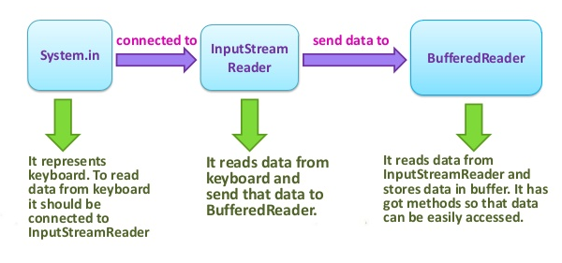
Console I/O
InputStreamReader class can be used to read data from keyboard. It performs two tasks:
connects to input stream of keyboard
converts the byte-oriented stream into character-oriented stream
BufferedReader Class is used to read the text from a character based input stream. It can be used to read data line by line by readLine() method. It makes the performance fast.
Example: KeyboardInput.java, KeyboardInput1.java
Notes:
Console I/O Using System
System.out is the “standard” output stream. This stream is already open and ready to accept output data. Typically, this stream corresponds to display output or another output destination specified by the host environment or user.
System.in is the “standard” input stream. This stream is already open and ready to supply input data. Typically, this stream corresponds to keyboard input or another input source specified by the host environment or user.
System.err is the “standard” error output stream. This stream is already open and ready to accept output data. Typically, this stream corresponds to display output or another output destination specified by the host environment or user. By convention, this output stream is used to display error messages or other information that should come to the immediate attention of a user even if the principal output stream, the value of the variable out, has been redirected to a file or other destination that is typically not continuously monitored.

Slide 23
Serialization and Deserialization
Saving data to some type of permanent storage is called persistence.
An object that is persistent-capable can be stored on disk (or any other storage device), or sent to another machine to be stored there. A non-persisted object exists only as long as the Java Virtual Machine is running.
Serialization is a process to convert objects into a writable byte stream. Once converted into a byte-stream, these objects can be written to a file. The reverse process of this is called de-serialization. This mechanism is used to persist the object.
A Java object is serializable if its class or any of its superclasses implement either the java.io.Serializable interface or its subinterface, java.io.Externalizable.
The java.io.Serializable interface defines no methods, and serves only as a marker to indicate that the class should be considered for serialization.
Notes:
Console I/O Using System
System.out is the “standard” output stream. This stream is already open and ready to accept output data. Typically, this stream corresponds to display output or another output destination specified by the host environment or user.
System.in is the “standard” input stream. This stream is already open and ready to supply input data. Typically, this stream corresponds to keyboard input or another input source specified by the host environment or user.
System.err is the “standard” error output stream. This stream is already open and ready to accept output data. Typically, this stream corresponds to display output or another output destination specified by the host environment or user. By convention, this output stream is used to display error messages or other information that should come to the immediate attention of a user even if the principal output stream, the value of the variable out, has been redirected to a file or other destination that is typically not continuously monitored.

Slide 24
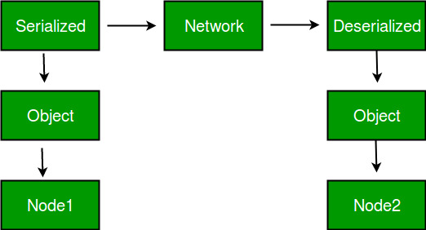
Serialization and Deserialization
Advantages of Serialization 1. To save/persist state of an object. 2. To travel an object across a network.
The byte stream created is platform independent. So, the object serialized on one platform can be deserialized on a different platform.
It is mainly used in Hibernate, RMI, JPA, EJB and JMS technologies.
Notes:
Console I/O Using System
System.out is the “standard” output stream. This stream is already open and ready to accept output data. Typically, this stream corresponds to display output or another output destination specified by the host environment or user.
System.in is the “standard” input stream. This stream is already open and ready to supply input data. Typically, this stream corresponds to keyboard input or another input source specified by the host environment or user.
System.err is the “standard” error output stream. This stream is already open and ready to accept output data. Typically, this stream corresponds to display output or another output destination specified by the host environment or user. By convention, this output stream is used to display error messages or other information that should come to the immediate attention of a user even if the principal output stream, the value of the variable out, has been redirected to a file or other destination that is typically not continuously monitored.

Slide 25
Serialization and Deserialization
The ObjectOutputStream class contains writeObject() method for serializing an Object.
public final void writeObject(Object obj) throws IOException
The ObjectInputStream class contains readObject() method deserializing an object.
public final Object readObject() throws IOException, ClassNotFoundException
Serial Version UID
During serialization, a version number, serialVersionUID, is used to associate the serialized output with the class used in the serialization process.
After deserialization, the serialVersionUID is checked to verify that the classes loaded are compatible with the object being deserialized.
Notes:
Console I/O Using System
System.out is the “standard” output stream. This stream is already open and ready to accept output data. Typically, this stream corresponds to display output or another output destination specified by the host environment or user.
System.in is the “standard” input stream. This stream is already open and ready to supply input data. Typically, this stream corresponds to keyboard input or another input source specified by the host environment or user.
System.err is the “standard” error output stream. This stream is already open and ready to accept output data. Typically, this stream corresponds to display output or another output destination specified by the host environment or user. By convention, this output stream is used to display error messages or other information that should come to the immediate attention of a user even if the principal output stream, the value of the variable out, has been redirected to a file or other destination that is typically not continuously monitored.

Slide 26
Serialization and Deserialization
If the receiver of a serialized object has loaded classes for that object with different serialVersionUID, deserialization will result in an InvalidClassException.
A serializable class can declare its own serialVersionUID by explicitly declaring a field named serialVersionUID as a static final and of type long:
private static long serialVersionUID = 42L;
Transient Keyword
Java transient keyword is used in serialization. If you define any data member as transient, it will not be serialized.
For Example: In Student class, it has three data members id, name and age. If you serialize the object, all the values will be serialized but I don't want to serialize one value, e.g. age then we can declare the age data member as transient.
Notes:
Console I/O Using System
System.out is the “standard” output stream. This stream is already open and ready to accept output data. Typically, this stream corresponds to display output or another output destination specified by the host environment or user.
System.in is the “standard” input stream. This stream is already open and ready to supply input data. Typically, this stream corresponds to keyboard input or another input source specified by the host environment or user.
System.err is the “standard” error output stream. This stream is already open and ready to accept output data. Typically, this stream corresponds to display output or another output destination specified by the host environment or user. By convention, this output stream is used to display error messages or other information that should come to the immediate attention of a user even if the principal output stream, the value of the variable out, has been redirected to a file or other destination that is typically not continuously monitored.

Slide 27
Serialization and Deserialization
Points to remember:
If a parent class has implemented Serializable interface then child class doesn’t need to implement it but vice-versa is not true.
Only non-static data members are saved via Serialization process.
Static data members and transient data members are not saved via Serialization process. So, if you don’t want to save value of a non-static data member then make it transient.
Constructor of object is never called when an object is deserialized.
Associated objects must be implementing Serializable interface.
Example: Serialization1.java, Serialization2.java
Notes:
Console I/O Using System
System.out is the “standard” output stream. This stream is already open and ready to accept output data. Typically, this stream corresponds to display output or another output destination specified by the host environment or user.
System.in is the “standard” input stream. This stream is already open and ready to supply input data. Typically, this stream corresponds to keyboard input or another input source specified by the host environment or user.
System.err is the “standard” error output stream. This stream is already open and ready to accept output data. Typically, this stream corresponds to display output or another output destination specified by the host environment or user. By convention, this output stream is used to display error messages or other information that should come to the immediate attention of a user even if the principal output stream, the value of the variable out, has been redirected to a file or other destination that is typically not continuously monitored.

